Slide 1
Weather Forecasting

Slide 2
Acquisition of Weather Information
10,000 land-based stations, hundreds of ships and buoys; four times a day, airports hourly
Upper level: radiosonde, aircraft, satellites
United Nations World Meteorological Organization, 175 countries(UNWMO)
World Meteorological Centers: Melbourne, Moscow, Washington D.C.
NCEP, US NWS
ASOS

Slide 3
Weather Forecasting Tools
High speed data modeling systems (AWIPS): communication, storage, processing, and display
Doppler radar
Satellite imagery
Forecast charts
Soundings
Wind profiles

Slide 4
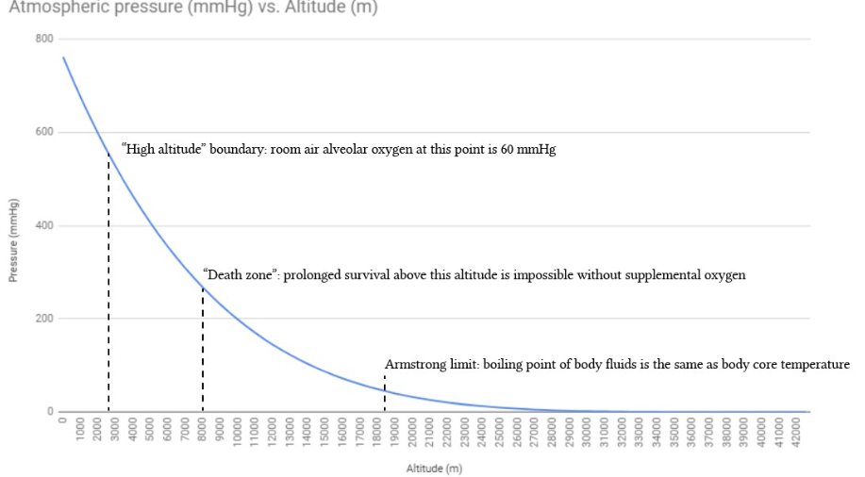

Slide 5
Weather Forecasting Tools
Topic: Watches, Warnings, and Advisories
Advisories: potential hazardous conditions; wind, wind chill, heat, urban and small stream, snow, dense fog
Watch: atmospheric conditions favoring hazardous weather over a region in time, actual location and time not known; flash flood, severe thunderstorm, tornado, hurricane
Warning: imminent or occurring hazardous weather over a region in time; high wind, heat, flash flood, severe storm, tornado, hurricane, winter storm, blizzard, gale, storm

Slide 6
Weather Forecasting Methods
Topic: Thickness Charts
Difference in height between two constant pressure surfaces (100mb-500mb)
Higher thickness equals warmer air
Assumptions
Models not global
Regions with few observations
Cannot model small-scale features
All factors cannot be modeled
Ensemble Forecasts:
Spaghetti model, robust

Slide 7
Observation: Weathercasters
Chroma key or color separation
Types of Forecasts
Now cast <6 hrs
Short range 12-65 hrs
Medium range 3-8.5 days
Long Range >8.5 days
Accuracy and Skill
12-24 hrs most accurate, 2-5 days good
Skill = more accurate than a forecast utilizing persistence of climatology

Slide 8
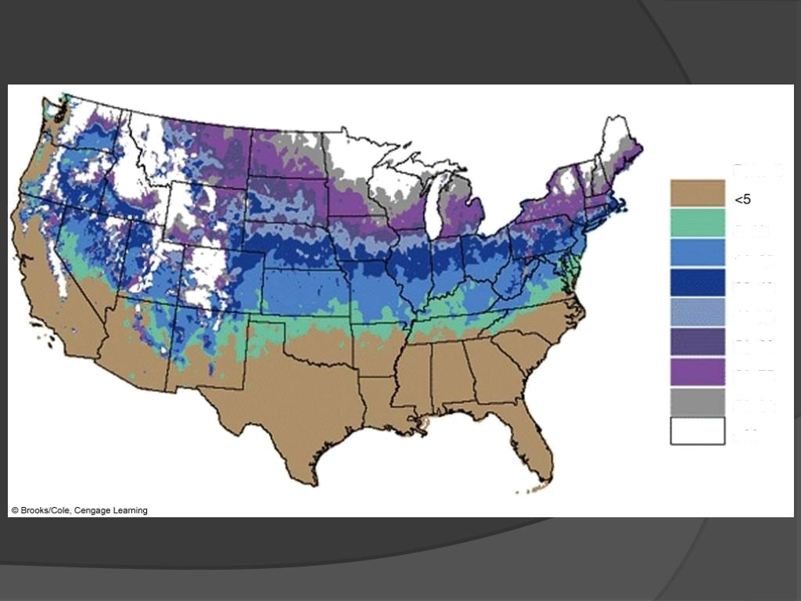
Percent
W10 11—25 TO 41—50
51—80
61-75
7Œ-90

Slide 9
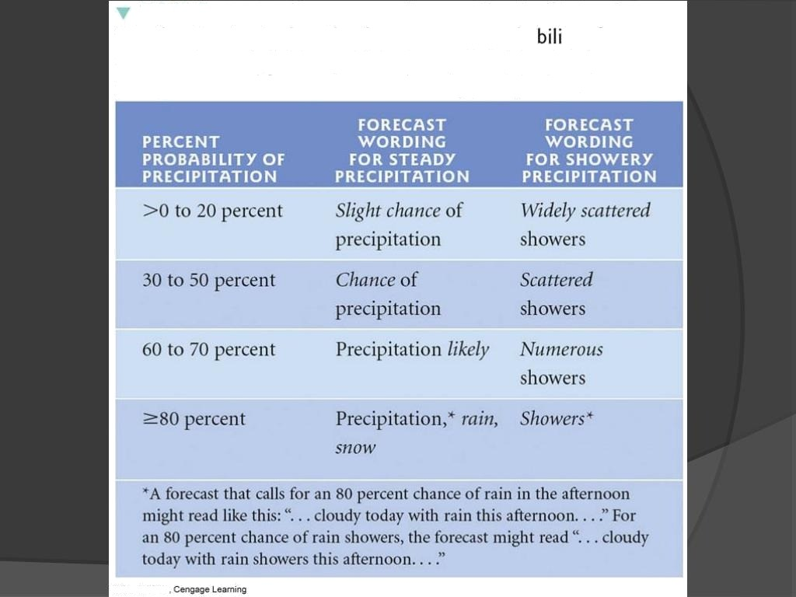
TA B L E I 3.2 Forecast wording used by the National
Weather Service to describe the percentage probability of measurable precipitation (0.01 inch or greater) for steady precipitation and for convective, showery precipitation

Slide 10
Thank you

